Slide 1
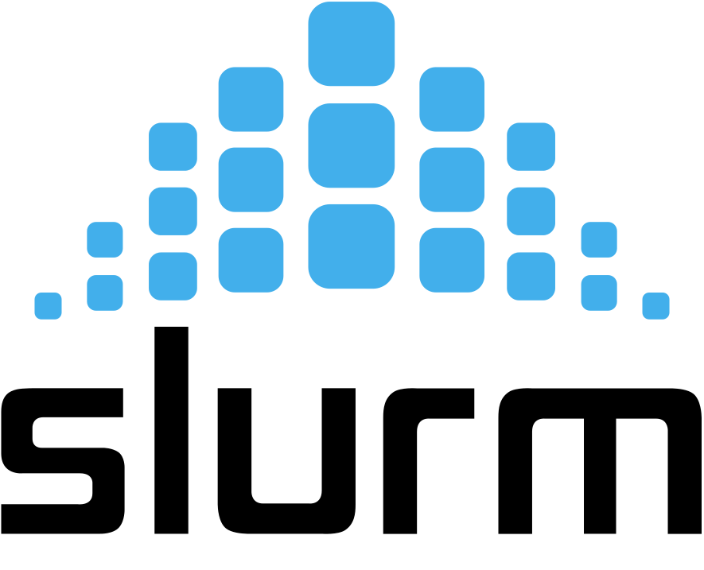



Storage
node
job request
ssh
job assigned
Storage
node
Frontend node
Storage
node
Local User
Compute
node
Compute
node
Compute
node

